Slide 1
relational aesthetics
to dynamic query:
experimenting
participatory art
curated by Tanya Abraham

Slide 2
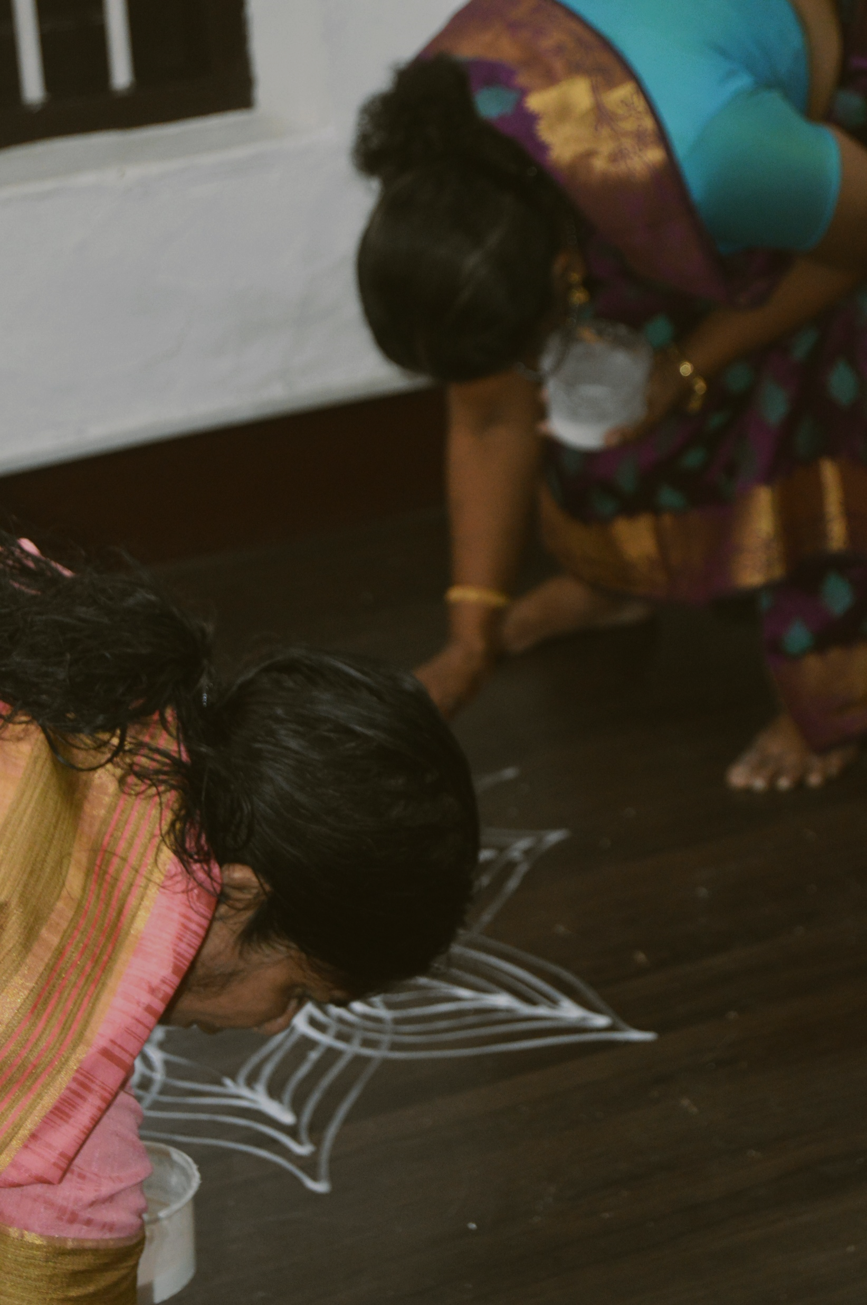
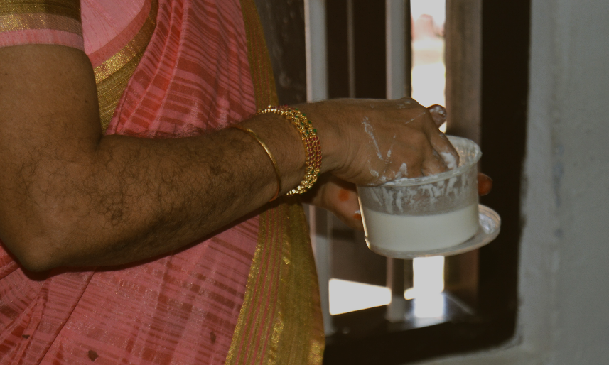
The “Relational Aesthetics to Dynamic Query: Experimenting Partcipatory Art” project was conceived in layers.
First, with the idea of intersecting traditional art forms with healing practices. Second, the use of the content to create digital art by artists. The third was using “public spaces” as exhibition arenas, where contemporary art practices look at new spaces for larger audience reach and knowledge dissemination.
The project’s final output, a digital artwork by Pinkoblu; artists Dipanshu and Pius, is exhibited at a popular bar in Kochi called Velocity.
As the politics of domestic abuse, gender positioning, and healing concerning the women are examined, the digital work is meant to push a relationship with the viewer, evoking an interchange of new understandings.
Curated by Kochi-based art curator Tanya Abraham, her work emphasizes gender positioning in Kerala and the need for sororities to combat sociocultural differences created by a patriarchal system. The project’s core is raising voices for awareness on domestic violence amongst women in Kerala, using a familiar art form (kolam art by the ancient Tamil Brahman community in Mattancherry), coupled with the therapeutic idea of mandalas. The kolam practitioners become mediums in this participatory art, intersecting the healing process through mandala making. The project aims at community participation, sharing lived experiences, and creating hegemony towards social change.

Slide 3
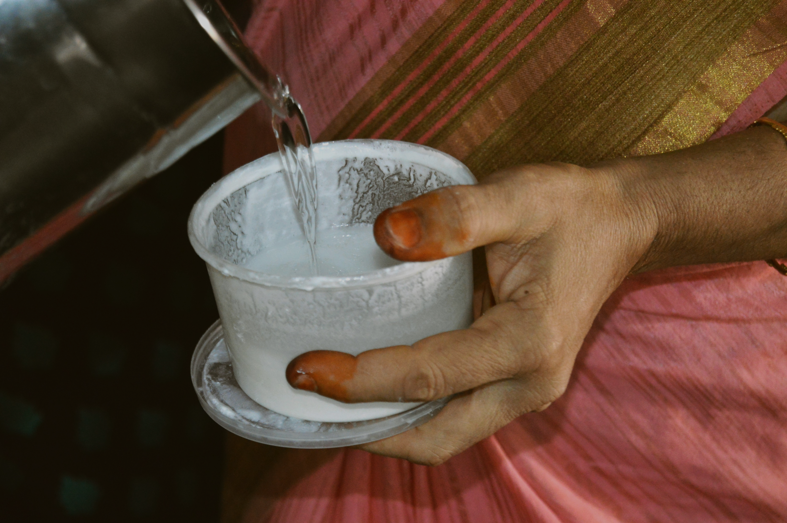
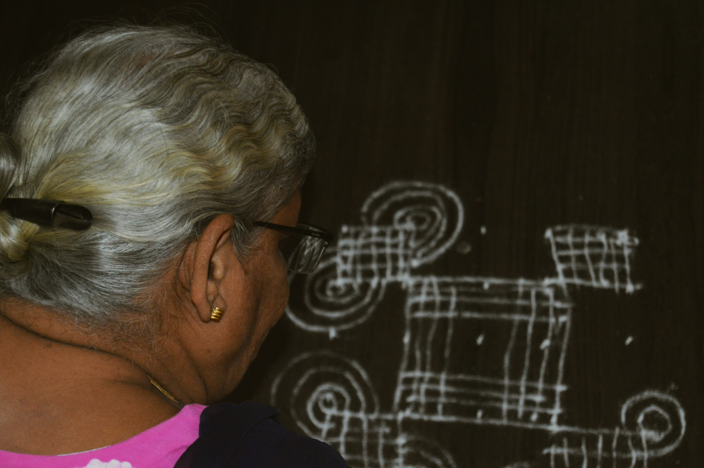

Slide 4
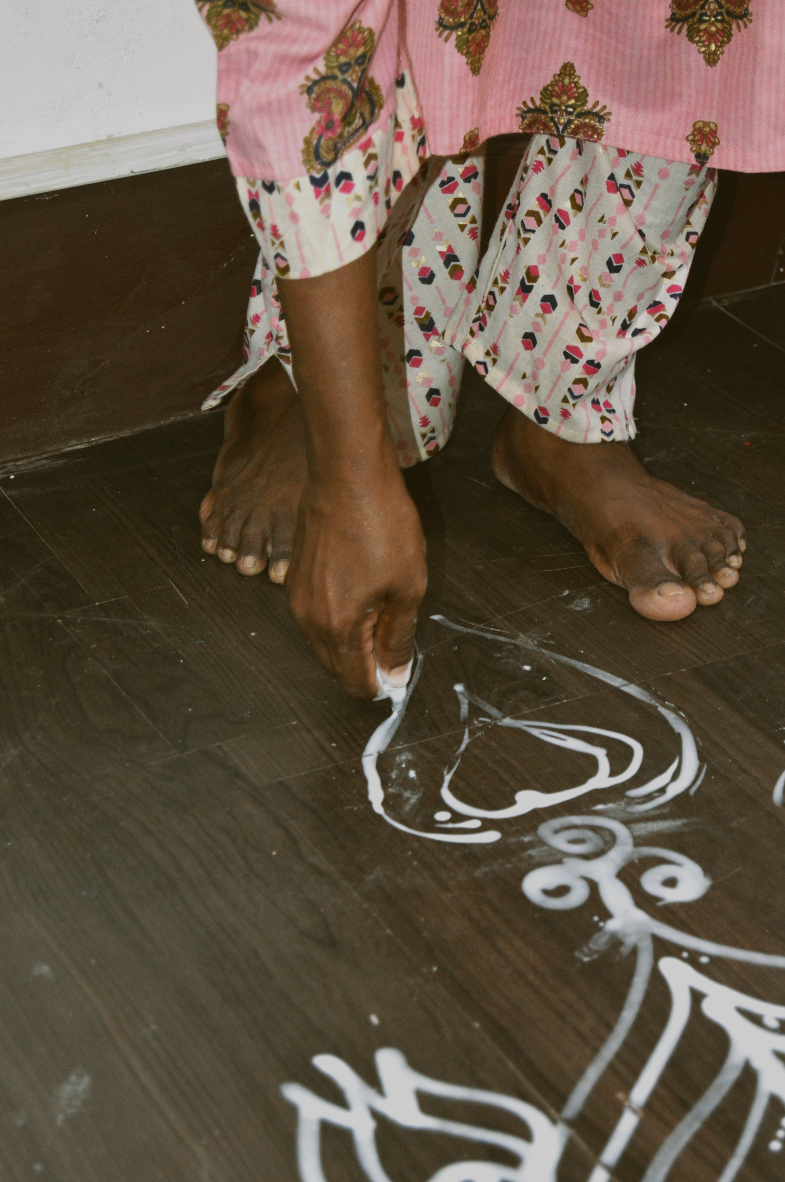

Slide 5
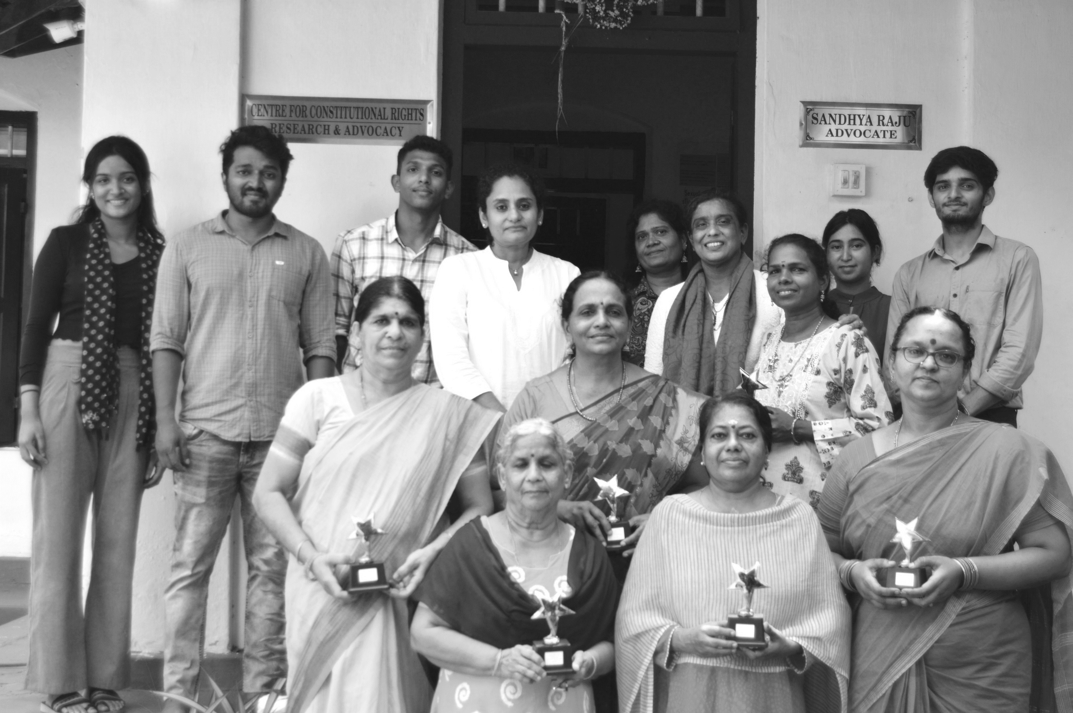
CURATOR
Tanya Abraham
KOLAM ARTISTS
Jayashree Iyer
Jayashree Subramaniam
Kamala
Revati
Shanti Parameshwaran
Vasantha Ramakrishnan
DESIGN CREW
Dipanshu
Irene Joseph Chiramel
Pius
VISUALS & DOCUMENTATION
Irene Joseph Chiramel
SPECIAL THANKS TO
Dr.Reema Cherian
Ashick Aldrin
Adammya Parasher
Mini
Adv. Sandhya Raju
Adv. Aswathi
Joseph
Adnan
Bindu

